Slide 1

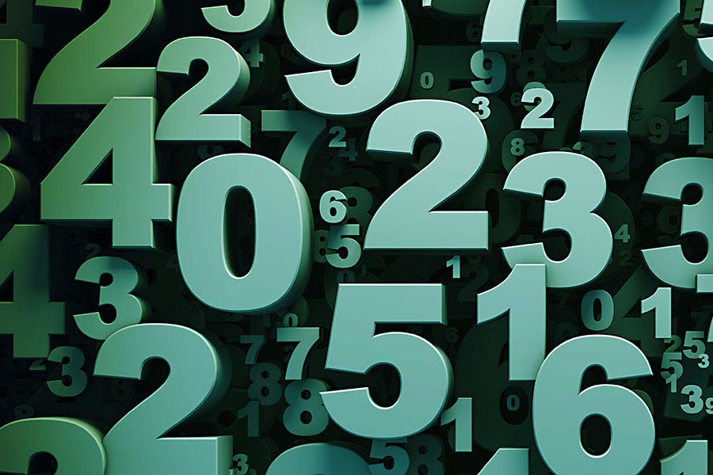
AdaBoost Regressor
Jayashree M

Slide 2
What is AdaBoost Regressor?
AdaBoost (Adaptive Boosting) Regressor
A machine-learning algorithm used for predicting numbers
Combines many weak models (simple decision trees)
Each model tries to correct the errors of the previous one
Works best when data is clean and not extremely large

Slide 3
Why is AdaBoost Useful?
Simple and easy to understand
Reduces mistakes step-by-step
Focuses more on difficult-to-predict data points
Often performs better than a single tree
Can be used on small to medium datasets

Slide 4
How AdaBoost Regressor Works
Train a simple decision tree (weak model)
Check where it made errors
Give higher weight to those difficult examples
Train the next tree focusing more on those errors
Repeat this process many times
Final prediction = weighted sum of all small trees
Easy idea: Each new model learns from the mistakes of the last one.

Slide 5
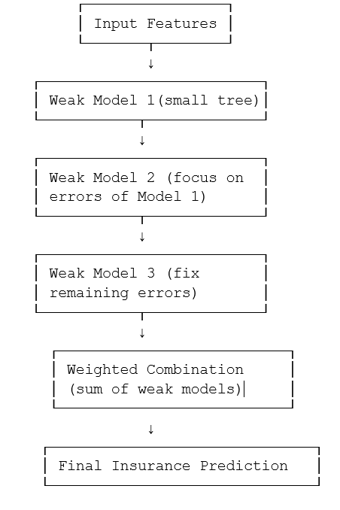
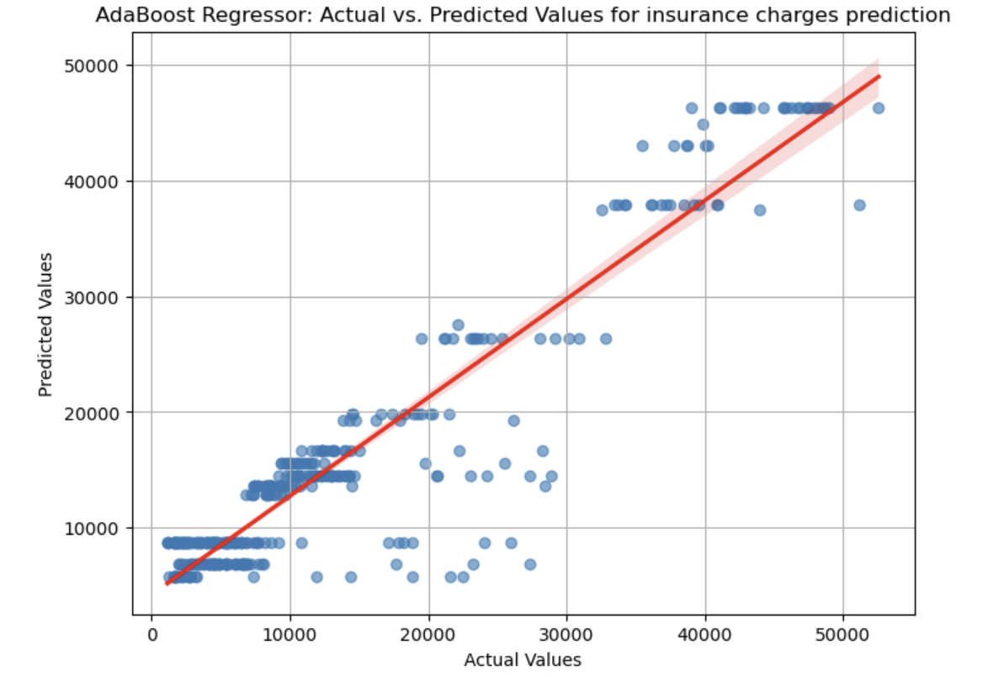
Example : Insurance charges Prediction

Slide 6
Thank You

